Slide 1
Computational Genomics
Lecture #2
Hirshberg linear space alignment
Local alignment
Heuristic alignment: FASTA and BLAST
Intro to ML and Scoring functions
Background Readings: Chapters 2.5, 2.7 in Biological Sequence Analysis, Durbin et al., 2001.
Chapters 3.5.1- 3.5.3, 3.6.2 in Introduction to Computational Molecular Biology, Setubal and Meidanis, 1997.
Chapter 11 in Algorithms on Strings, Trees, and Sequences, Gusfield, 1997.
This class has been edited from Nir Friedman’s lecture which is available at www.cs.huji.ac.il/~nir. Changes made by Dan Geiger, then Shlomo Moran, and finally Benny Chor.

Slide 2
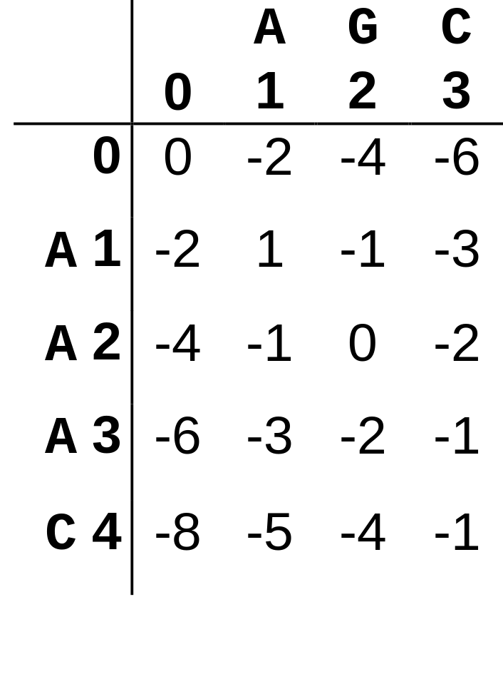
Global Alignment (reminder)
Last time we saw a dynamic programming algorithm
to solve global alignment,
whose performance is
Space: O(mn)
Time: O(mn)
Filling the matrix O(mn)
Backtrace O(m+n)
Reducing time to o(mn)
is a major open problem
T
S

Slide 3
Space Complexity
In real-life applications, n and m can be very large
The space requirements of O(mn) can be too demanding
  If m = n = 1000, we need 1MB space
  If m = n = 10000, we need 100MB space
In general, time is cheaper than space.
We can afford to perform some extra computation
in order to save space
Can we trade space with time?

Slide 4
Why Do We Need So Much Space?
To compute the value V[n,m]=d(s[1..n],t[1..m]),
we need only O(min(n,m)) space:
A
G
C
Compute V(i,j), column by
column, storing only two columns in memory (or line by line if lines are shorter).
0
1
2
3
0
0
-2
-4
-6
A
1
-2
1
-1
-3
Note however that
This “trick” fails when we need
to reconstruct the optimizing sequence.
Trace back information requires O(mn) memory.
A
2
-4
-1
0
-2
A
3
-6
-3
-2
-1
C
4
-8
-5
-4
-1

Slide 5
Hirshberg’s Space Efficient Algorithm
Input: Sequences s[1,n] and t[1,m] to be aligned.
Idea: Divide and conquer
If n=1, align s[1,1] and t[1,m]
Else, find position (n/2, j) at which an optimal alignment crosses the midline
s
Construct alignments
  A=s[1,n/2] vs t[1,j]
  B=s[n/2+1,n] vs t[j+1,m]
  Return AB
t

Slide 6
Finding the Midpoint
The score of the best alignment that goes through j equals:
V(s[1,n/2],t[1,j]) + V(s[n/2+1,n],t[j+1,m])
So we want to find the value(s) of j that maximizes this sum
optimal alignment goes
through (n/2,j).
s
t

Slide 7
Finding the Midpoint
The score of the best alignment that goes through j equals:
V(s[1,n/2],t[1,j]) + V(s[n/2+1,n],t[j+1,m])
Want to compute these two quantities
for all values of j.
Let F[i,j] = V(s[1,i],t[1,j])
(“forward”).
Compute F[i,j] just
like we did before.
Get all F[n/2,j]
s
t

Slide 8
Finding the Midpoint
The score of the best alignment that goes through j equals:
V(s[1,n/2],t[1,j]) + V(s[n/2+1,n],t[j+1,m])
We want to compute these two quantities
for all values of j.
Let B[i,j] = V(s[i+1,n],t[j+1,m])
(“backwars”)
Hey - B[i,j] is not something
we already saw – these are not
prefixes of s[1,n],t[1,m] !
s
t

Slide 9
Finding the Midpoint
B[i,j] = V(s[i+1,n],t[j+1,m]) is the value of optimal alignment between a suffix of s and a suffix of t.
But in the lecture we only talked about alignments between two prefixes.
Don’t be ridiculous: Think
backwards.
B[i,j] is the value of optimal
alignment between prefixes
of s reversed and t reversed.
s
t

Slide 10
Algorithm: Finding the Midpoint
Define
F[i,j] = V(s[1,i],t[1,j]) (“forward”)
B[i,j] = V(s[i+1,n],t[j+1,m]) (“backward”)
F[i,j] + B[i,j] = score of best alignment through (i,j)
We compute F[i,j] as we did before
We compute B[i,j] in exactly the same manner, going “backward” from B[n,m]

Slide 11
Space Complexity of Hirshberg Algorithm
We first find j where F[i,n/2] + B[n/2+1,j] is
maximized. To do this, we need just to compute
values of F[,],B[,], which take O(n+m) space.
Once midpoint computed, we keep it in memory,
(consant memory), then solve recursive the sub-
problems.
Recursion depth is O(log n). Memory requirement is
O(1) per level + O(m+n) reusable memory at all
recursion levels
= O(n+m) memory overall.

Slide 12
Time Complexity of Hirshberg Algorithm
Time to find a mid-point: cnm (c - a constant)
Size of two recursive sub-problems is
(n/2,j) and (n/2,m-j-1), hence
T(n,m) = cnm + T(n/2,j) + T(n/2,m-j-1)
Lemma: T(n,m) ≤ 2cnm
Proof (by induction):
T(n,m) ≤ cnm + 2c(n/2)j + 2c(n/2)(m-j-1) ≤ 2cnm.
Thus, time complexity is linear in size of the DP matrix
At worst, twice the cost of the regular solution.

Slide 13
Local Alignment
The alignment version we studies so far is called
global alignment: We align the whole sequence s
to the whole sequence t.
Global alignment is appropriate when s,t are highly
similar (examples?), but makes little sense if they
are highly dissimilar. For example, when s (“the query”)
is very short, but t (“the database”) is very long.

Slide 14
Local Alignment
When s and t are not necessarily similar, we may want to consider a different question:
Find similar subsequences of s and t
Formally, given s[1..n] and t[1..m] find i,j,k, and l such that V(s[i..j],t[k..l]) is maximal
This version is called local alignment.

Slide 15
Local Alignment
As before, we use dynamic programming
We now want to setV[i,j] to record the maximum value over all alignments of a suffix of s[1..i]
and a suffix of t[1..j]
In other words, we look for a suffix of a prefix.
How should we change the recurrence rule?
  Same as before but with an option to start afresh
The result is called the Smith-Waterman algorithm, after its inventors (1981).

Slide 16
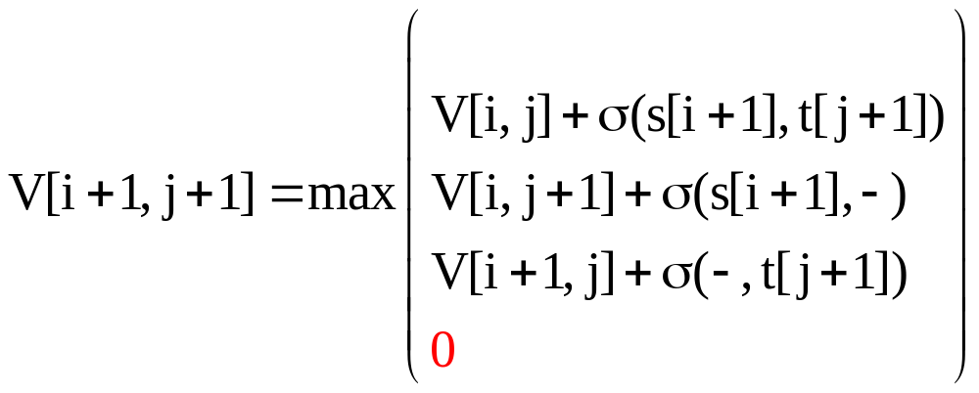
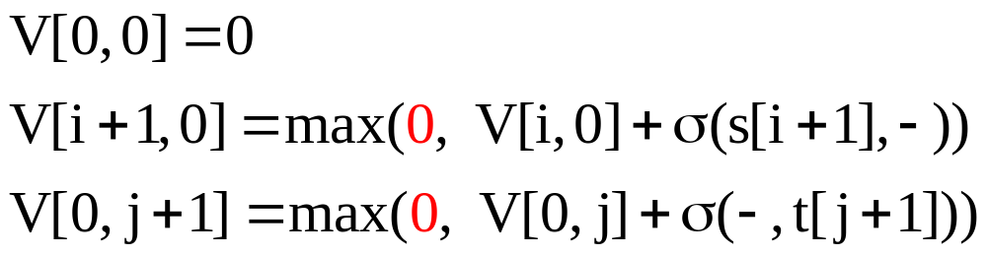
Local Alignment
New option:
We can start a new alignment instead of extending a previous one
Alignment of empty suffixes

Slide 17
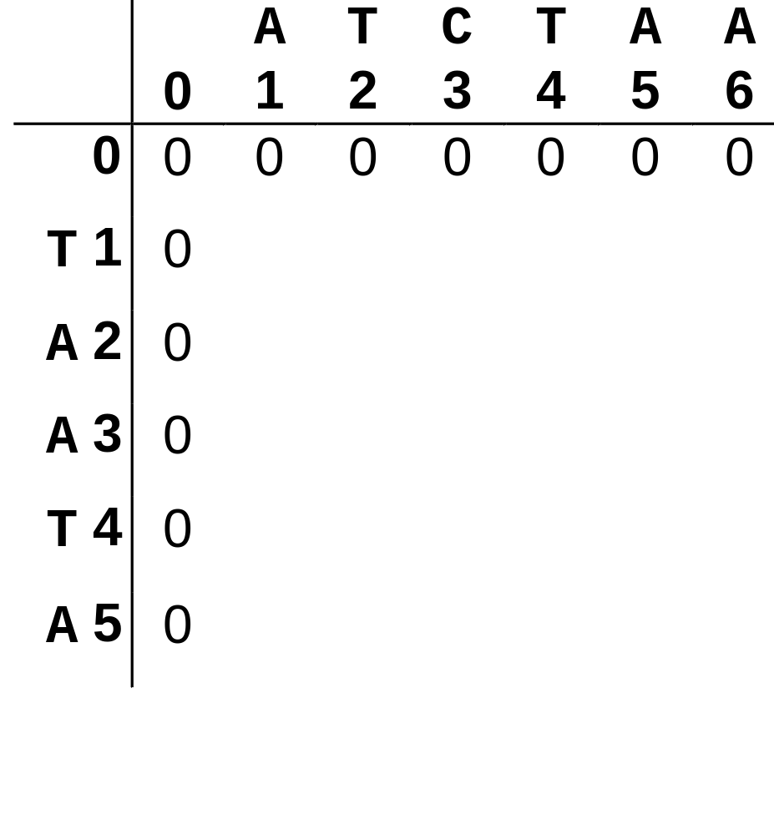
Local Alignment Example
T
S
s = TAATA
t = TACTAA

Slide 18
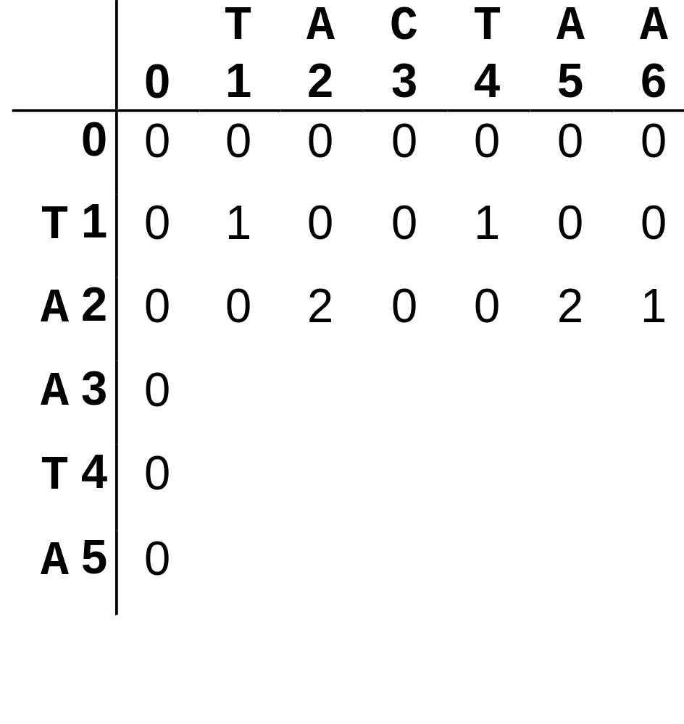
Local Alignment Example
T
S
s = TAATA
t = TACTAA

Slide 19
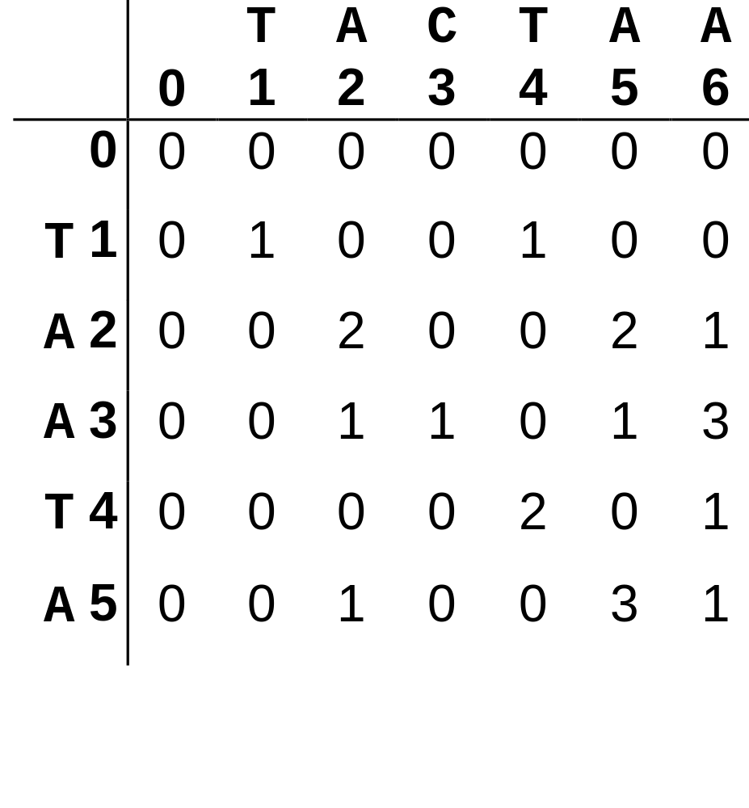
Local Alignment Example
T
S
s = TAATA
t = TACTAA

Slide 20
Local Alignment Example
T
S
s = TAATA
t = TACTAA

Slide 21
Local Alignment Example
T
S
s = TAATA
t = TACTAA

Slide 22
Local-Global Alignment
Take all of T (query) vs. a subsequence of S (database)
We now want to setV[i,j] to record the maximum value over all alignments of a suffix of S[1..i]
and all of of T[1..j]
How should we change the recurrence rule?
A good (and not too hard) exercise to think about.

Slide 23
Similarity vs. Distance
Two related notions for sequences comparisons:
Roughly (and not very accurately)
Similarity of 2 sequences? Count matches.
Distance of 2 sequences? Count mismatches.
HIGH SIMILARITY = LOW DISTANCE
Similarity can be either positive or negative.
Distance is always non-negative ( >0).
Identical sequences have zero (0) distance.

Slide 24
Similarity vs. Distance
So far, the scores of alignments we saw with were
similarity scores (e.g. +1 for match, -1 for mismatch, -2 for indel)
We sometimes want to measure distance between sequences
rather than similarity (e.g. in evolutionary, distance based
reconstruction).
Can we convert one score to the other (similarity to distance)?
What should a distance function satisfy?
Of the global and local versions of alignment, only one is
appropriate for distance formulation (why? which one?)

Slide 25
Remark: Edit (Levenshtein) Distance
In many stringology applications, one often talks about the edit
distance between two sequences, defined to be the minimum
number of edit operations needed to transform one sequence
into the other. This distance satisfies triangle inequality.
  “no change” is charged 0
  “replace” and “indel” are charged 1
  Remark: Sometimes 2 letter “transposition” also charged 1
This problem (without transposition) can be solved as a global
distance alignment problem, using DP. It can easily be
generalized to have unequal “costs” of replace and indel.
To prevent indel-only editing, “replace” should
not be more expensive than two “indels”.
aaa---
---bbb

Slide 26

Alignment with affine gap scores
Observation: Insertions and deletions often occur in blocks longer than a single nucleotide.
Consequence: Standard scoring of alignment studied so far, which give a constant penalty d per gap unit , does not reflect this phenomenon; Hence, a better gap score model is needed.
Question: Can you think of an appropriate change to the scoring system for gaps?

Slide 27
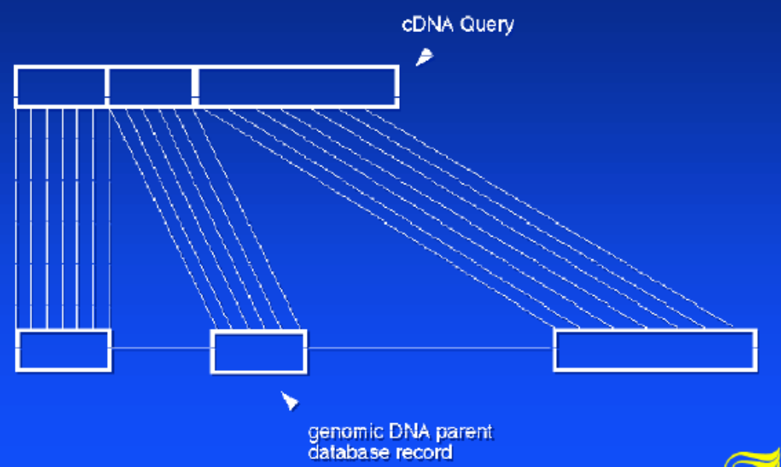
More Motivation for Gap Penalties
(Improved Pricing of InDels)
Motivation: Aligning cDNAs to Genomic DNA
Example:
cDNA query
Genomic DNA
In this case, if we penalize every single gap by -1, the similarity score
will be very low, and the parent DNA will not be picked up.

Slide 28
Variants of Sequence Alignment
We have seen two variants of sequence alignment :
Global alignment
Local alignment
Other variants, in the books and in recitation, can also be solved with the same basic idea of dynamic programming.
:
Using an affine cost V(g) = -d –(g-1)e for gaps of length g. The –d (“gap open”) is for introducing a gap, and the –e (“gap extend”) is for continuing the gap. We used d=e=2 in the naïve scoring, but could use smaller e.
Finding best overlap

Slide 29
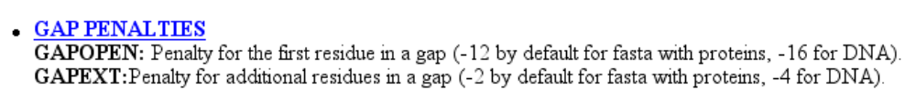
Specific Gap Penalties in Use
Motivation
Insertions and deletions are rare in evolution.
But once they are created, they are easy to extend.
Examples (in the popular BLAST and FASTA, to be
studied soon):
BLAST: Cost to open a gap = 10 (high penalty).
Cost to extend a gap = 0.5 (low penalty).
FASTA:

Slide 30
Alignments with Affine Gap Penalties
We discuss the global alignment version.
Local can be treated similarly.
Let a=gap open penalty, b=gap extend penalty.
Define V(i,j)= value of optimal alignment between
prefix i of S and prefix j of T.
G(i,j)= value of optimal alignment between
prefix i of S and prefix j of T, ending in S[i] vs. T[j].
F(i,j)= value of optimal alignment between
prefix i of S and prefix j of T, ending in S[i] vs. -.
E(i,j)= value of optimal alignment between
prefix i of S and prefix j of T, ending in - vs. T[j].

Slide 31

Alignments with Affine Gap Penalties
Using a, b, V(i,j), G(i,j), F(i,j), and E(i,j), can develop
recurrence relations for optimal value (& alignment).
E.g.
V(i,j)=max (G(i,j), F(i,j), E(i,j))
F(i,j) (S[i] vs. -) = max
( G(i-1,j) – a (open a new gap),
F(i-1,j) – b (extend existing gap:
had S[i-1] vs. - , now have S[i] vs. -),
E(i-1,j) – a (open a new gap:
had T[j] vs. -, now have S[i] vs. -) )
Etc. (don’t forget boundaries – basis of recursion)
➔ O(mn) time algorithm.

Slide 32
Alignment in Real Life
One of the major uses of alignments is to find sequences in a large “database” (e.g. genebank).
The current protein database contains about 100 millions (i.e.,10⁸) residues! So searching a 1000 long target sequence requires to evaluate about 10¹¹ matrix cells which will take approximately three hours for a processor running 10 millions evaluations per second.
Quite annoying when, say, 1000 target sequences need to be searched because it will take about four months to run.
So even O(nm) is too slow. In other words, forget it!

Slide 33
Heuristic Fast Search
Instead, most searches rely on heuristic procedures
These are not guaranteed to find the best match
Sometimes, they will completely miss a high-scoring alignment
But in the vast majority of cases, they do an excellent job
We now describe the main ideas used by the best known of these heuristic procedures.

Slide 34
Basic Intuition
Almost all heuristic search procedures are based on the observation that good real-life alignments often contain long runs with no gaps (mostly
matches, maybe a few mismatches).
These heuristic try to find significant gap-less runs and then extend them.

Slide 35
A Simple Graphical Representation - Dot Plot
C T T A G G A C T
G
A
G
G
A
C
T
Put a dot at every position with identical nucleotides in the two sequences.
Sequences:
C T T A G G A C T
G A G G A C T

Slide 36
A Simple Graphical Representation - Dot Plot
C T T A G G A C T
G
A
G
G
A
C
T
Put a dot at every position with identical nucleotides in the two sequences.
Long diagonals with dots - long matches (good !)
C T T A G G A C T
G A G G A C T
Short dotted diagonals - short matches (unimpressive)
C T T A G G A C T
G A G G A C T

Slide 37
Getting Rid of Short Diagonals -
“word size”
C T T A G G A C T
G
A
G
G
A
C
T
Start with original dot plot.
Retain a run along a diagonal
only if it has “word size”
length of 6 or more
(for DNA).
This “word size” is called Ktup in Fasta, W in Blast

Slide 38
Banded DP
Suppose that we have two strings s[1..n] and t[1..m] such that n≈m
If the optimal alignment of s and t has few gaps, then path of the alignment will be close to diagonal
s
t

Slide 39
Banded DP
To find such a path, it suffices to search in a diagonal region of the matrix.
If the diagonal band has width k, then the dynamic programming step takes O(kn).
Much faster than O(n²) of standard DP.
Boundary values set to 0 (local alignment)
s
V[i,i+k/2]
V[i, i+k/2+1]
t
k
Out of range
V[i+1, i+k/2 +1]
Note that for diagonals i-j = constant.

Slide 40
Banded DP for local alignment
Problem: Where is the banded diagonal ? It need not be the main diagonal when looking for a good local alignment.
s
How do we select which subsequences to align using banded DP?
t
k
We heuristically find potential diagonals and evaluate them using Banded DP.
This is the main idea of FASTA.

Slide 41
Finding Potential Diagonals
Suppose that we have a relatively long gap-less match
AGCGCCATGGATTGAGCGA
TGCGACATTGATCGACCTA
Can we find “clues” that will let us find it quickly?
Each such sequence defines a potential diagonal (which is then evaluated using Banded DP.

Slide 42
Signature of a Match
Assumption: good alignments contain several “patches” of perfect matches
AGCGCCATGGATTGAGCTA
TGCGACATTGATCGACCTA
Since this is a gap-less alignment,
all perfect match regions
should be on one diagonal
s
t

Slide 43
FASTA-finding ungapped matches
Input: strings s and t, and a parameter ktup
Find all pairs (i,j) such that s[i..i+ktup]=t[j..j+ktup]
Locate sets of matching pairs that are on the same diagonal
  By sorting according to the difference i-j
Compute the score for the diagonal that contains all these pairs
s
t

Slide 44
FASTA-finding ungapped matches
Input: strings s and t, and a parameter ktup
Find all pairs (i,j) such that s[i..i+ktup]=t[j..j+ktup]
  Step one: Preprocess an index of the database:
  For every sequence of length ktup, make a list of
  all positions where it appears. Takes linear time (why?).
  Step two: Run on all sequences of size ktup on the query sequence. ( time is linear in query size). Identify all matches (i,j).
s
t

Slide 45
FASTA- using banded DP
Final steps:
  List the highest scoring diagonal matches
  Run banded DP on the region containing any high scoring diagonal (say with width 12).
  Hence, the algorithm may combine some diagonals into gapped matches (in the example below combine diagonals 2 and 3).
s
2
t
3
1

Slide 46
FASTA- practical choices
Most applications of FASTA use fairly small ktup (2 for proteins, and 6 for DNA).
Higher values are faster, yielding fewer diagonals to search around, but increase the chance to miss the optimal local alignment.
s
t
Some implementation choices / tricks have not been explicated herein.

Slide 47
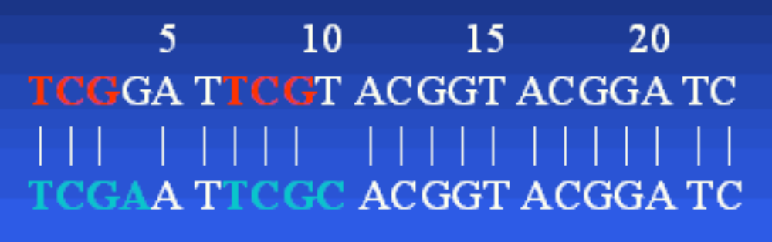
Effect of Word Size (ktup)
Large word size - fast, less sensitive, more selective:
distant relatives do not have many runs of matches,
un-related sequences stand no chance to be selected.
Small word size - slow, more sensitive, less selective.
Example: If ktup = 3, we will consider all substrings
containing TCG in this sequence (very sensitive
compared to large word size, but less selective.
Will find all TCGs).

Slide 48
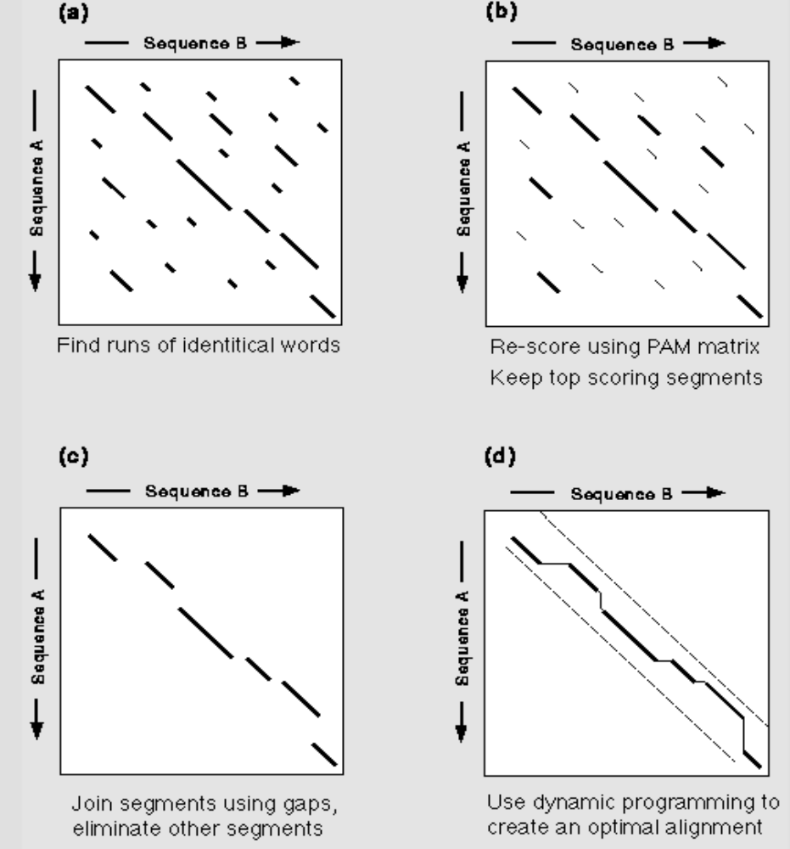
FASTA
Visualization
Identify all hot spots
longer than Ktup.
Ignore all short hot spots. The longest hot spot is called init₁.
Extend hot spots
to longer diagonal
runs. Longest diagonal
run is init_{n}.
Merge diagonal runs.
Optimize using SW
in a narrow band.
Best result is called
opt.

Slide 49
FastA Output
FastA produces a list, where each entry looks like:
EM_HUM:AF‭267177 Homo sapiens glucocer (5420) [f] 3236 623 1.1e-176
The database name and entry (accession numbers).
Then comes the species.
and a short gene name.
The length of the sequence.
Scores:
Similarity score of the optimal alignment (opt).
The bits score,
and the E-value.
Both measure the statistical
significance of the alignment.

Slide 50
FastA Output - Explanation
E-value is the theoretically Expected number of false hits (“random sequences”) per sequence query, given a similarity score (a statistical significance threshold
for reporting matches against database sequences).
Low E-value means: high significance,
fewer matches will be reported.
Bits is an alternative statistical measure for significance.
High bits means high significance. Some versions also
display z-score, a measure similar to Bits.

Slide 51
What Is a Significant E-Value ?
How many false positives to expect?
For E-value: 10 ^{– 4} = 1 in 10,000
Database No. of Entries False Positive
SwissProt 105,967 10.6
PIR-PSD 283,153 28.3
TrEMBL 594,148 59.4

Slide 52
Expect Value (E) and Score (S)
The probability that an alignment score as good
as the one found between a query sequence and
a database sequence would be found by random
chance.
  Example: Score E-value
  108 10 ^{–2}
  = >1 in 100 will have the same score.
For a given score, the E-value increases with increasing
size of the database.
For a given database, the E-value decreases exponentially with increasing score.

Slide 53
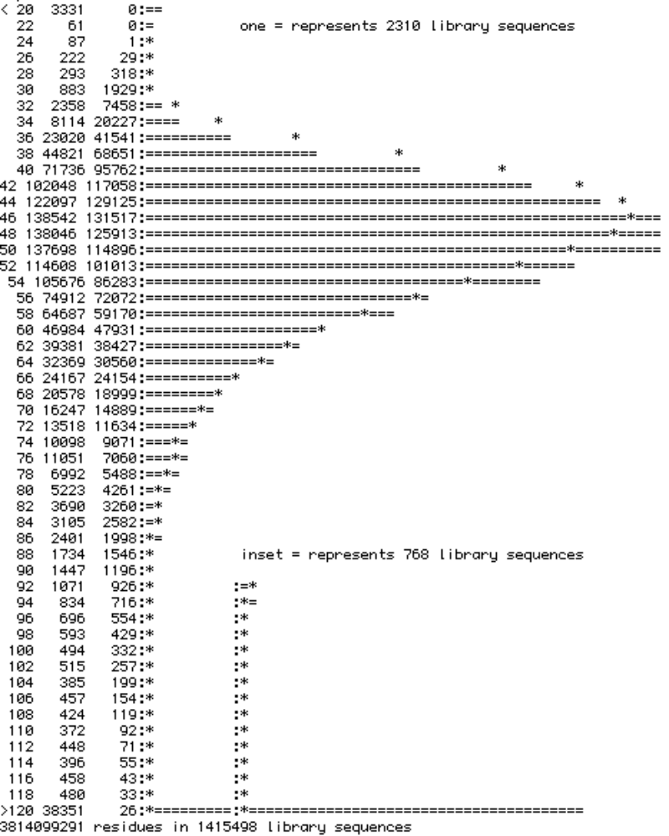
opt
A Histogram for
observed (=) vs
expected (*)
the “usual” bell curve
“Unexpected”, high
score sequences
(signal vs noise)

Slide 54
FASTA-summary
Input: strings s and t, and a parameter ktup = 2 or 6 or user’s choice, depending on the application.
Output: A high score local alignment
Find pairs of matching substrings s[i..i+ktup]=t[j..j+ktup]
Extend to ungapped diagonals
Extend to gapped alignment using banded DP
Can you think of example for pairs of sequences that
have high local similarity scores but will be missed by
FASTA ?

Slide 55
BLAST Overview
Basic Local Alignment Search Tool
(BLAST is one of the most quoted papers ever)
Input: strings s and t, and a parameter T = threshold value
Output: A highly scored local alignment
Definition: Two strings s and t of length k are a high scoring pair (HSP) if V(s,t) > T (usually consider un-gapped alignments only, but not necessarily perfect matches).
Find high scoring pairs of substrings such that V(s,t) > T
These words serve as seeds for finding longer matches
Extend to ungapped diagonals (as in FASTA)
Extend to gapped matches

Slide 56
BLAST Overview (cont.)
Step 1: Find high scoring pairs of substrings such that V(s,t) > T (The seeds):
  Find all strings of length k which score at least T with substrings of s in a gapless alignment (k = 4 for AA, 11 for DNA)
  Find in t all exact matches with each of the above strings.

Slide 57
Extending Potential Matches
Once a seed is found, BLAST attempts to find a local alignment that extends the seed.
Seeds on the same diagonal are combined (as in FASTA), then extended as far as possible in a greedy manner.
s
During the extension phase, the search stops when the score passes below some lower bound computed by BLAST (to save time).
A few extensions with highest score
are kept, and attempt to join them is
made, even if they are on distant
diagonals, provided the join improves
both scores.
t

Slide 58
BLAST Facts
BLAST is the most frequently used sequence alignment program.
An impressive statistical theory, employing issues of the renewal
theorem, random walks, and sequential analysis was developed
for analyzing the statistical significance of BLAST results. These
are all out of scope for this course.
See the book ``Statistical Methods in BioInformatics” by
Ewens and Grant (Springer 2001) for more details.

Slide 59
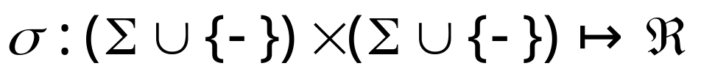
Scoring Functions, Reminder
So far, we discussed dynamic programming algorithms for
  global alignment
  local alignment
All of these assumed a scoring function:
that determines the value of perfect matches,
substitutions, insertions, and deletions.

Slide 60
Where does the scoring function come from ?
We have defined an additive scoring function by specifying a function σ( •, • ) such that
  σ(x,y) is the score of replacing x by y
  σ(x,-) is the score of deleting x
  σ(-,x) is the score of inserting x
But how do we come up with the “correct” score ?
Answer: By encoding experience of what are similar sequences for the task at hand. Similarity depends on time, evolution trends, and sequence types.

Slide 61
Why probability setting is appropriate to define and interpret a scoring function ?
Similarity is probabilistic in nature because biological changes like mutation, recombination, and selection, are random events.
We could answer questions such as:
  How probable it is for two sequences to be similar?
  Is the similarity found significant or spurious?
  How to change a similarity score when, say, mutation rate of a specific area on the chromosome becomes known ?

Slide 62
A Probabilistic Model
For starters, will focus on alignment without indels.
For now, we assume each position (nucleotide /amino-acid) is independent of other positions.
This is not a very realistic assumption, BUT it makes
our life a lot easier.
We consider two options:
  M: the sequences are Matched (related)
  R: the sequences are Random (unrelated)

Slide 63
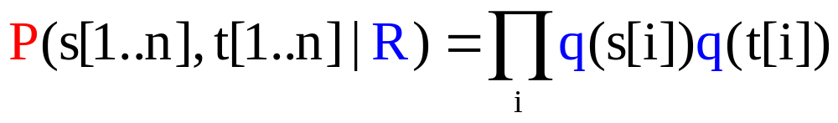
Unrelated Sequences (R)
Our random model R of unrelated sequences is simple
  Each position is sampled independently from a distribution over the alphabet Σ
  We assume there is a distribution q(•) that describes the probability of single letters.
Then:

Slide 64
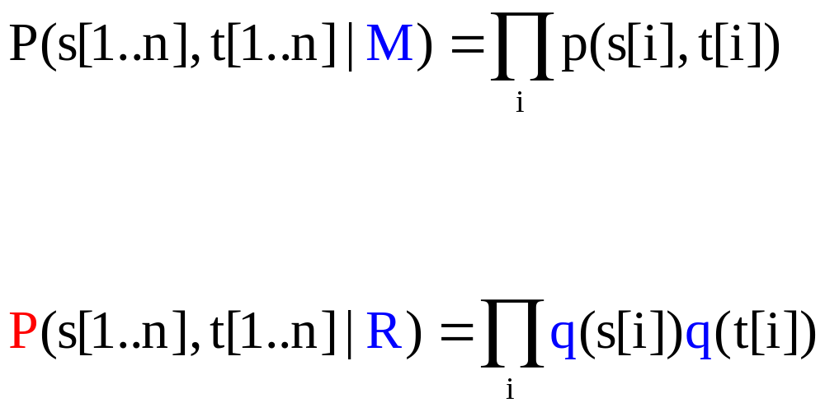
Related Sequences (M)
We assume that each pair of aligned positions (s[i],t[i]) evolved from a common ancestor
Let p(a,b) be a distribution over pairs of letters.
p(a,b) is the probability that some ancestral letter evolved into this particular pair of letters.
Compare to:

Slide 65
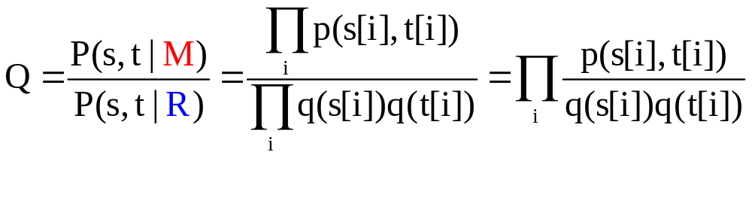
Odd-Ratio Test for Alignment
If Q > 1, then the two strings s and t are more likely to
be related (M) than unrelated (R).
If Q < 1, then the two strings s and t are more likely to
be unrelated (R) than related (M).

Slide 66
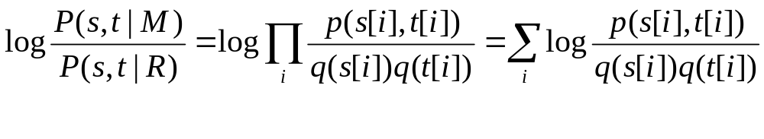
Log Odd-Ratio Test for Alignment
Taking logarithm of Q yields
Score(s[i],t[i])
If log Q > 0, then s and t are more likely to be related.
If log Q < 0, then they are more likely to be unrelated.
(usually we want some constant positive threshold to
“declare” relatedness).
How can we relate this quantity to a score function ?

Slide 67
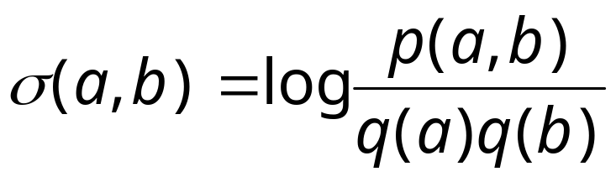
Probabilistic Interpretation of Scores
We define the scoring function via
Then, the score of an alignment is the log-ratio between the two models:
  Score > 0 ⇒ Model is more likely
  Score < 0 ⇒ Random is more likely

Slide 68
Modeling Assumptions
It is important to note that this interpretation depends on our modeling assumption!!
For example, if we assume that the letter in each position depends on the letter in the preceding position, then the likelihood ratio will have a different form.
If we assume, for proteins, some joint distribution of letters that are nearby in 3D space after protein folding, then likelihood ratio will again be different.

Slide 69
Estimating Probabilities
Suppose we are given a long string s[1..n] of letters from Σ
We want to estimate the distribution q(·) that generated the sequence
How should we go about this?
We build on the theory of parameter estimation in statistics using either maximum likelihood estimation or the Bayesian approach .

Slide 70
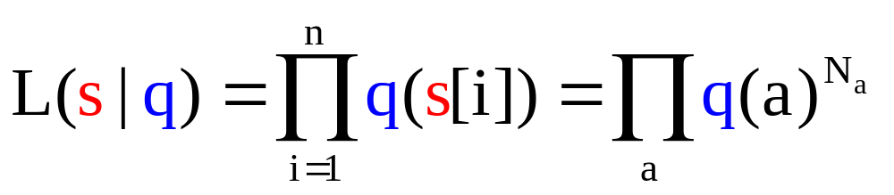
Estimating q(•)
Suppose we are given a long string s[1..n] of letters from Σ
  s can be the concatenation of all sequences in our database
We want to estimate the distribution q(•)
That is, q is defined per single letters
Likelihood function:

Slide 71
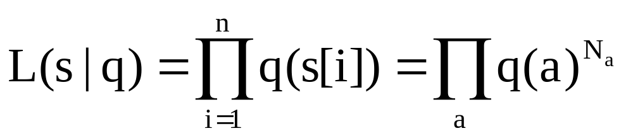
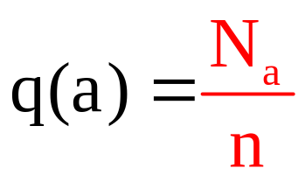
Estimating q(•) (cont.)
How do we define q?
Likelihood function:
ML parameters
(Maximum Likelihood)

Slide 72
Crash Course on Maximum Likelihood: Binomial Experiment
Head
Tail
When tossed, this device (“thumbtack”) can land in one of
two positions: Head or Tail
We denote by θ the (unknown) probability P(H).
Estimation task:
Given a sequence of toss samples x[1], x[2], …, x[M] we want to estimate the probabilities P(H)= θ and P(T) = 1 - θ

Slide 73
Statistical Parameter Fitting
Consider instances x[1], x[2], …, x[M] such that
  The set of values that x can take is known
  Each is sampled from the same distribution
  Each sampled independently of the rest
i.i.d.
samples
The task is to find a vector of parameters Θ that have generated the given data. This vector parameter Θ can be used to predict future data.
Notes:
i.I.d - idependent, identically distributed

Slide 74
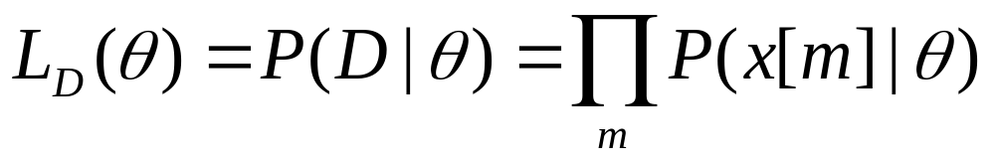
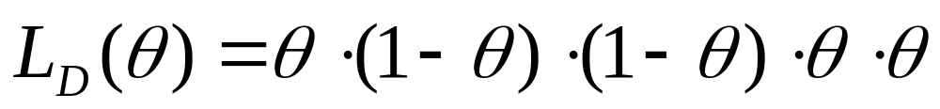
The Likelihood Function
How good is a particular θ?
It depends on how likely it is to generate the observed data
The likelihood for the sequence H,T, T, H, H is
L(θ)
0
0.2
0.4
θ
0.6
0.8
1

Slide 75
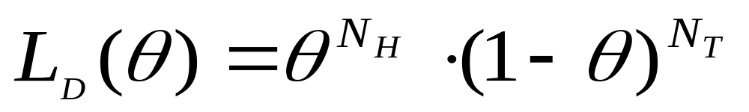
Sufficient Statistics
To compute the likelihood in the thumbtack example we only require N_{H} and N_{T}
(the number of heads and the number of tails)
N_{H} and N_{T} are sufficient statistics for the binomial distribution
Notes:
For example: H,T,T,H,H is just like T,H,H,H,T

Slide 76
Sufficient Statistics
A sufficient statistic is a function of the data that summarizes the relevant information for the likelihood
Formally, s(D) is a sufficient statistics if for any two datasets D and D’
  s(D) = s(D’ ) ⇒ L_{D}(θ) = L_{D’} (θ)
Datasets
Statistics

Slide 77
Maximum Likelihood Estimation
MLE Principle:
Choose parameters that maximize the likelihood function
This is one of the most commonly used estimators in statistics
Intuitively appealing
One usually maximizes the log-likelihood function defined as l_{D}(θ) = log_{e}L_{D}(θ)

Slide 78
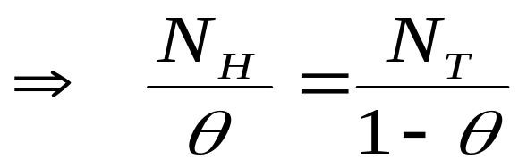

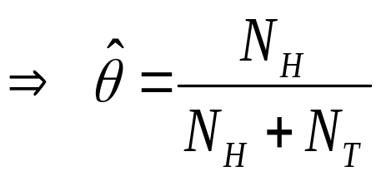
Example: MLE in Binomial Data
Applying the MLE principle (taking derivative) we get
(Which coincides with what one would expect)
Example:
(N_{H},N_{T} ) = (3,2)
MLE estimate is 3/5 = 0.6
L(θ)
0
0.2
0.4
0.6
0.8
1

Slide 79
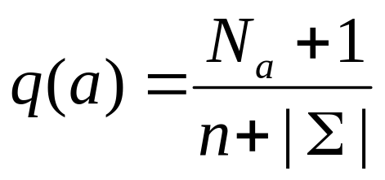
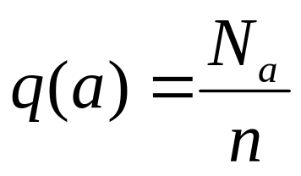
Estimating q(•) (cont.)
How do we define q?
Likelihood function:
ML parameters
(Maximum Likelihood)
MAP parameters
(Maximum A posteriori Probability)

Slide 80
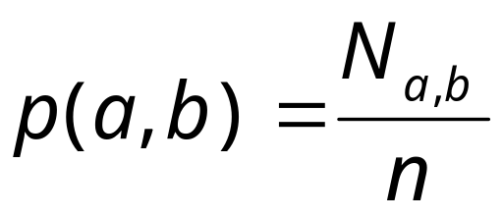
Estimating p(·,·)
Intuition:
Find pair of aligned sequences s[1..n], t[1..n],
Estimate probability of pairs:
The sequences s and t can be the concatenation of many aligned pairs from the database
Number of times a is
aligned with b in (s,t)

Slide 81
Problems in Estimating p(·,·)
How do we find pairs of aligned sequences?
How far is the ancestor ?
  earlier divergence ⇒ low sequence similarity
  recent divergence ⇒ high sequence similarity
Does one letter mutate to the other or are they both mutations of a common ancestor having yet another residue/nucleotide acid ?

Slide 82
Estimating p(·,·) for proteins
An accepted mutation is a mutation due to an alignment of closely related protein sequences. For example, Hemoglobin alpha chain in humans and other organisms (homologous proteins).

Slide 83
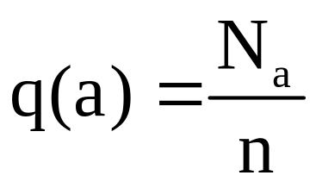
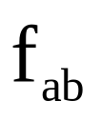
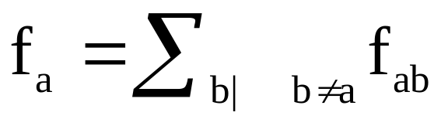
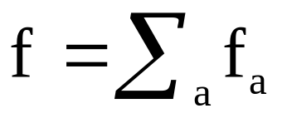
Estimating p(·,·) for proteins
Generate a large diverse collection of accepted mutations.
Recall that
Define: to be the number of mutations a ⇔ b,
to be the total number of mutations of a,
and to be the total number of amino acids involved
in a mutation.
Note that f is twice the number of mutations.

Slide 84


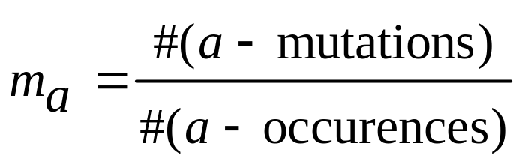
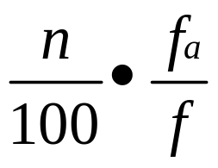

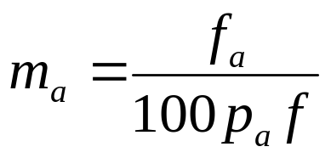
PAM-1 matrices
, The relative mutability of amino acid a, should reflect the
Probability that a is mutated to any other amino acid :
For PAM-1 take sequences with 1% of all amino acids mutated.
#(a-mutations) =
#(a-occurrences) =

Slide 85
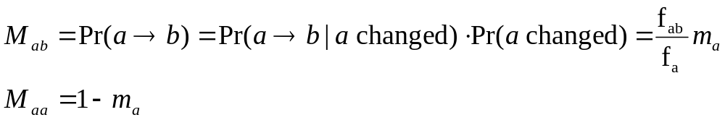
PAM-1 matrices
Define M_{ab} to be the probability matrix for switching from a to b via
A mutation

Slide 86
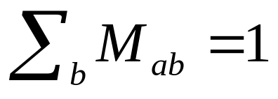
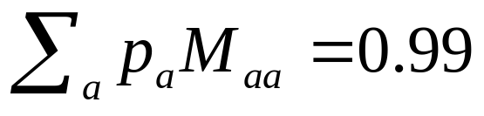
Properties of PAM-1 matrices
Note that
Namely, the probability of not changing and changing sums to 1.
Also note that
Namely, only 1% of amino acids change according to this matrix. Hence the name, 1-Percent Accepted Mutation (PAM).
This is a unit of evolutionary change, not time because evolution acts differently on distinct sequence types.
What is the substitution matrix for k units of evolutionary time ?

